Slide 1
Chatbots for Mental Health
RITIKA GARG
2018B3A70258H

Slide 2
Contents
Introduction
NLP for Chatbots
Types of Chatbots
Data Used for Training Models
Models Trained to Create Chatbots
Comparison between Models
Conclusion
References

Slide 3
Introduction
Mental health problems have increased among people in recent times, especially during the COVID-19 pandemic. Therefore there is rising need to finding methods to help people solve these problems. Apart from professional help like therapists and doctors, technology has also helped in this field.
One such solution is through a chatbot. The user will enter a question as input and the chatbot will give the most appropriate answer to the question as the output. To make the chatbot, Natural Language Processing is used along with different types of training models.

Slide 4
NLP for Chatbots
Tokenize- Chopping up of text into tokens, and throwing away unnecessary characters like punctuation.
Normalisation- Processing of text to look out for common spelling errors that might change the intent of the user’s request.
Recognising Entities- Helps the chatbot what is being talked about- a country or object or number etc.
Dependency Parsing-Splitting of sentences into nouns, verbs and other constituent objects, which would help understanding the user’s request and respond to it appropriately.
Generation-Finally, the response is generated using NLU and NLG

Slide 5
Types of Chatbots
Rule-Based Chatbots try to match the user input with the inputs provided in the given dataset and select the most suitable predefined response as the output.
Generative Chatbot are open-domain chatbot programs that generate original combinations of language rather than selecting from predefined responses.

Slide 6
Data Used for Chatbot Models
For training various kinds of chatbot models, we selected a .csv file consisting of 98 questions and answers about mental health problems. The dataset was available to us on Kaggle.
We took 10 question-answer pairs from this dataset and created a JSON file, consisting of tags for each of the pairs, 2-3 variations for each question and a response corresponding to each tag. This would help us in training rule-based chatbot models.
We used the original dataset in order to train an NLTK chatbot, which would be a generative chatbot model.

Slide 7
Models Trained For Mental Health Problems
Sequential Neural Network Model using Keras
A simple Neural Network Model was implemented using Keras to train the chatbot.
A JSON file consisting of tags, questions and responses on mental health problems was used as the dataset to train the model.
The link to the dataset is given below-
https://drive.google.com/file/d/1Vg7vsrP3EBybcgbJolXDq_iYFtCHrGVa/view?usp=sharing
The link to the chatbot colab file is given below-
https://colab.research.google.com/drive/1kaa-4KIJ-dPhGN6OkDyCCIgNswcbU-tG?usp=sharing

Slide 8
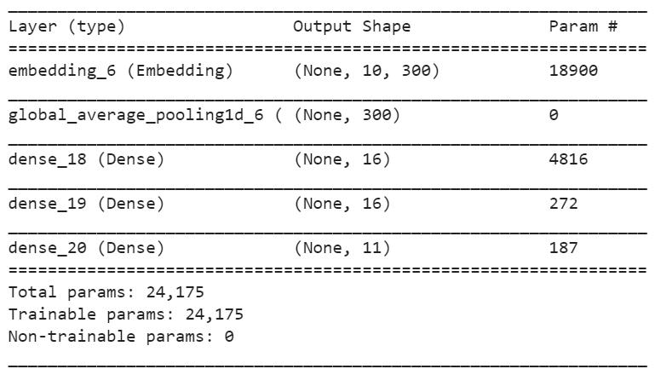
Model Summary

Slide 9
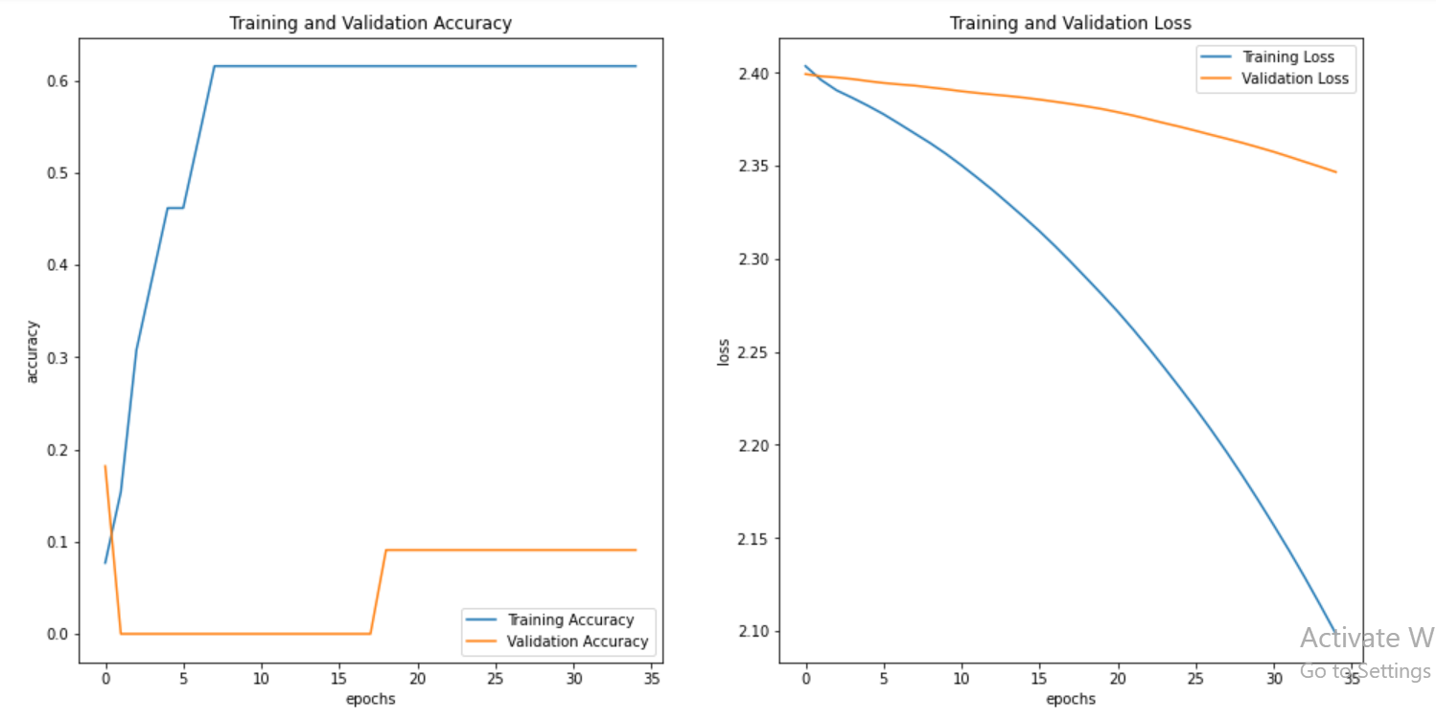
Accuracy and Loss Statistics
We trained the model to get a 61.54% accuracy shown below .

Slide 10
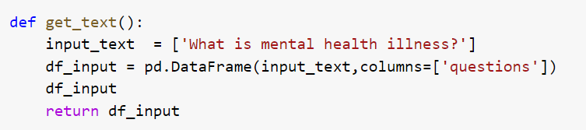
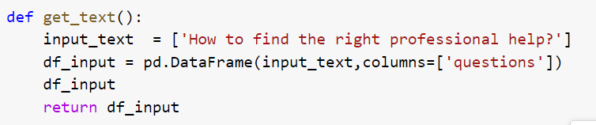
Demo for the Sequential Model

Slide 11
2. GRU Neural Network Model.
The RNN model is not used very frequently because of the vanishing gradient problem, which can be resolved by using the Gated Recurrent Units (GRU) in the activation function of the model trained.
A JSON file consisting of tags, questions and responses on mental health problems was used as the dataset to train the model.
The link to the dataset is given below-
https://drive.google.com/file/d/1Vg7vsrP3EBybcgbJolXDq_iYFtCHrGVa/view?usp=sharing
The link to the chatbot colab file is given below-
https://colab.research.google.com/drive/1Kgrik-wjM9AEl0QGkpRoMKh9Tv_gRKzG?usp=sharing

Slide 12
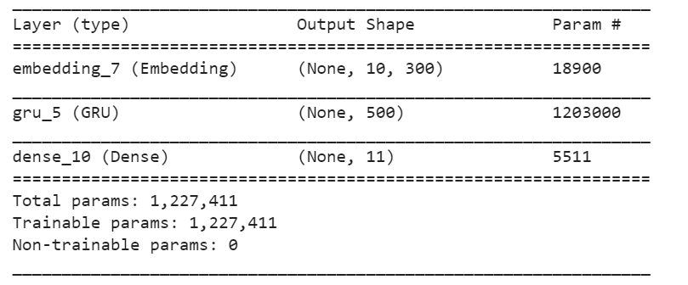
Model Summary

Slide 13
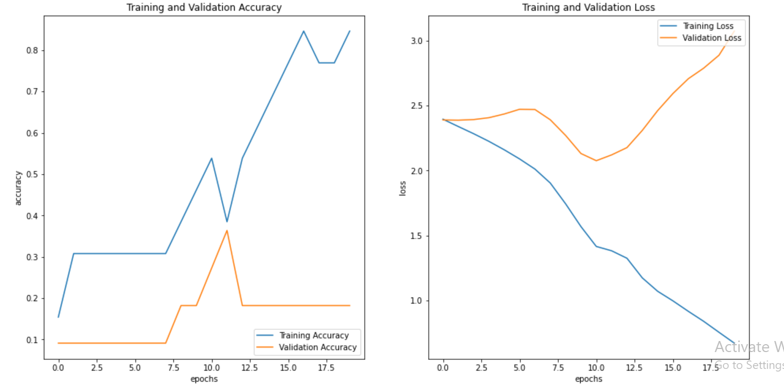
Accuracy and Loss Statistics
We trained the model to get an accuracy of 84.62%.

Slide 14
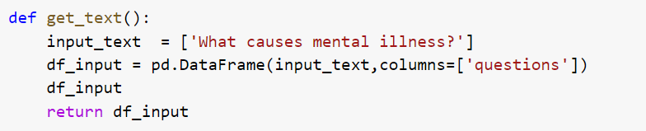
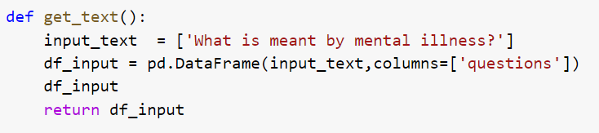
Demo for GRU Model

Slide 15
3. In order to create a more accurate Generative chatbot, we can use NLTK Library along with Cosine Similarity and TF-IDF to train the chatbot.
For this model, a CSV file consisting of Questions and Responses related to mental health issues was used as the dataset for the chatbot. The dataset consists of 98 Q/As divided in 3 columns- Question_ID, Questions and Responses.
The link to the dataset is given below-
https://drive.google.com/file/d/10WZ4xVNUtw0xN0EqCMPDmqGRRQWyvWla/view?usp=sharing
The link to the chatbot colab file is given below-
https://colab.research.google.com/drive/1-47bHuK3wj-7clZLfGf4HqisbANKBnMC?usp=sharing

Slide 16
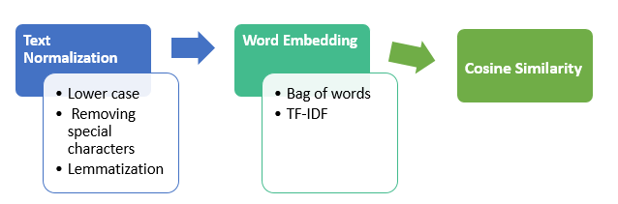
Steps Involved in the Chatbot

Slide 17
Cosine Similarity and TF-IDF
Cosine Similarity is a measure of similarity between two vectors. It returns a value that is computed by taking the dot product and dividing that by the product of their norms between two vectors.
Cosine Similarity (a, b) = Dot product(a, b) / ||a|| * ||b||
TF is Term Frequency, scoring of the frequency of the word in the current document and idf is Inverse Document Frequency, scoring of how rare the word is across documents.Here documents means a single row.

Slide 18
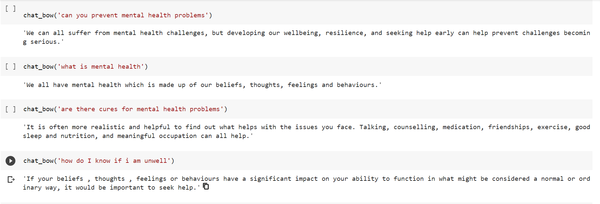
Demo for the NLTK Chatbot (Using Bag of Words)

Slide 19
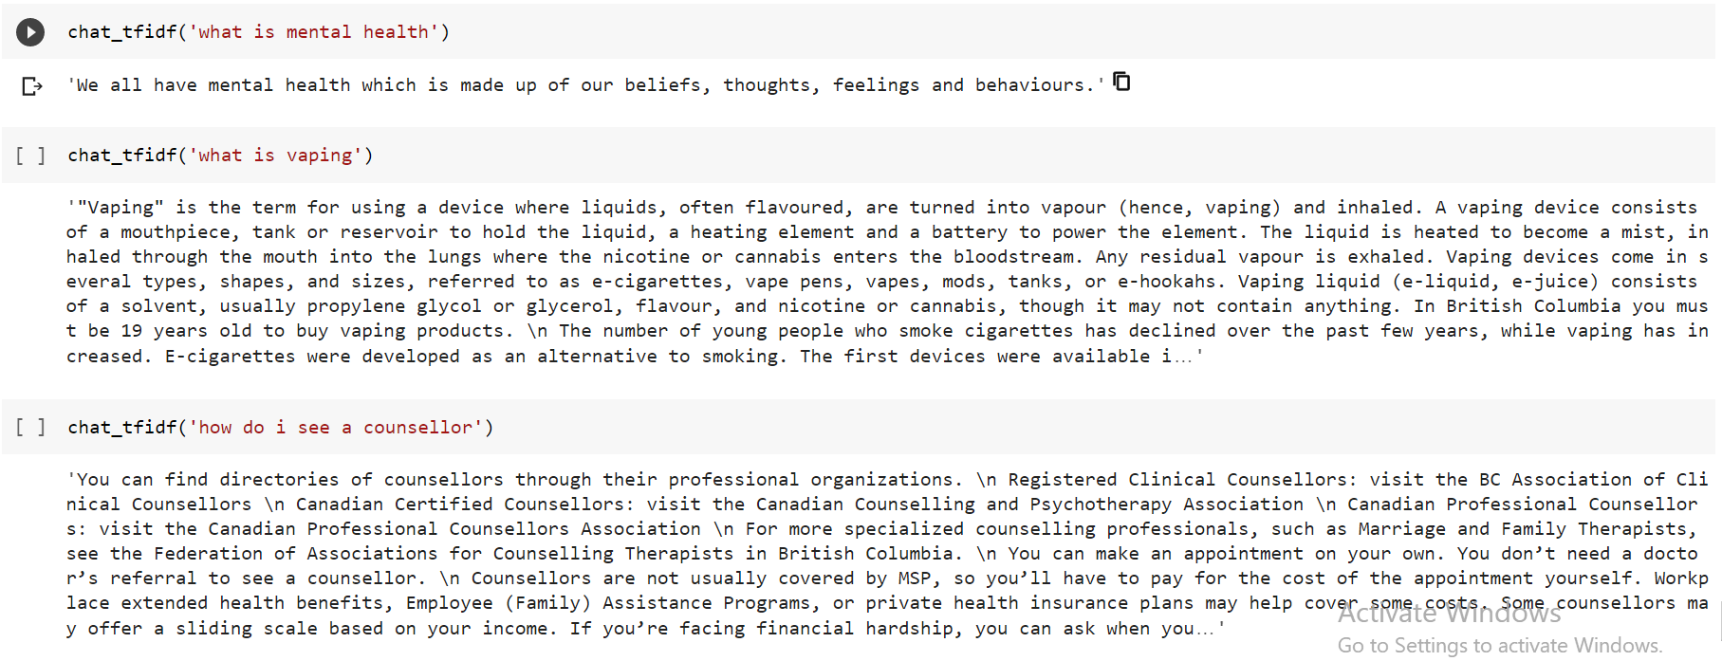
Demo for the NLTK Chatbot (Using TF-IDF)

Slide 20
Comparison Between the Models
From the given analysis, we can definitely say that GRU model will be preferred over the Keras model due to more accuracy and less overfitting for a rule-based chatbot.
The NLTK model will give correct responses for most of the input questions which makes it a good generative chatbot.
Now we compare the GRU model with an Encoder-Decoder model with the following accuracy and loss plots

Slide 21
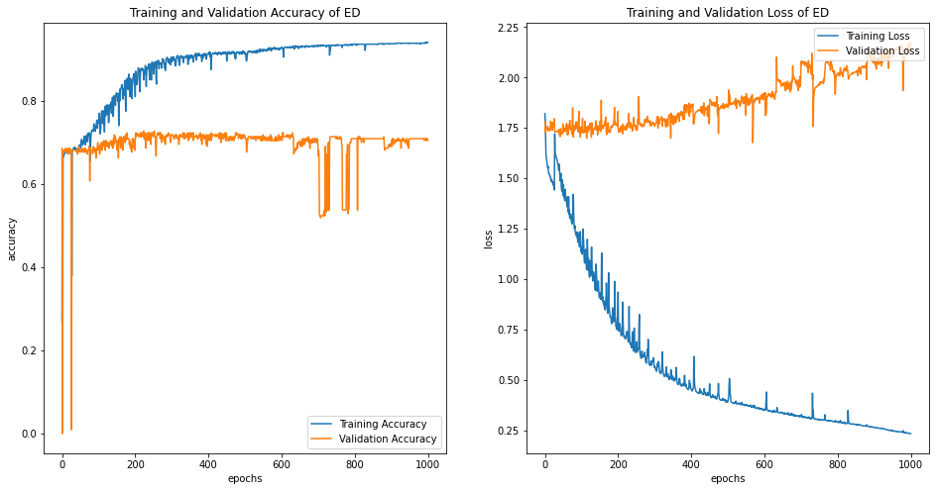
As we can see from the above plots, the encoder-decoder has an accuracy far better than the GRU model (94.75%) with even less overfitting, therefore we would prefer that for our rule-based chatbot.

Slide 22
Conclusion
We observe that among the models shown here, the NLTK chatbot would be the most suitable to create a Generative Based Chatbot model.
The NLTK chatbot does not need intents pre defined in order to generate responses, and can generate responses if the user frames his/her input question differently.
The Encoder-Decoder can be considered the most suitable for a Rule-Based Chatbot model.
There is overfitting in the models, which can reduced by increasing the size of the dataset in order to make the chatbot model more generalised.

Slide 23
References
https://towardsdatascience.com/how-to-build-your-own-chatbot-using-deep-learning-bb41f970e281
(For the Keras Model)
https://www.researchgate.net/publication/323587007_Deep_Learning_Based_Chatbot_Models#pf27
https://heartbeat.fritz.ai/building-a-conversational-chatbot-with-nltk-and-tensorflow-part-1-f452ce1756e5
(For the GRU based Chatbot)
https://medium.com/swlh/a-chatbot-in-python-using-nltk-938a37a9eacc
(For the NLTK Chatbot)

